Slide 1
Prolonged Sitting:
The Sitting Disease
How your chair is killing you
and why the gym won’t save you
Audrey Hemlinger
BWC Ergonomist
Garfield Heights Service Office
Audrey.B.1@bwc.state.oh.us
(216)-385-1353

Slide 2
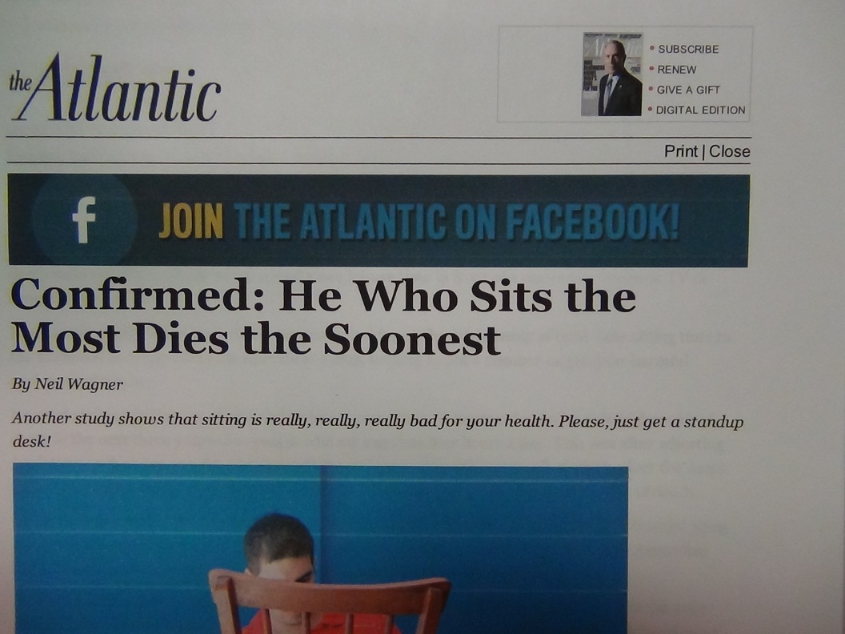

Slide 3
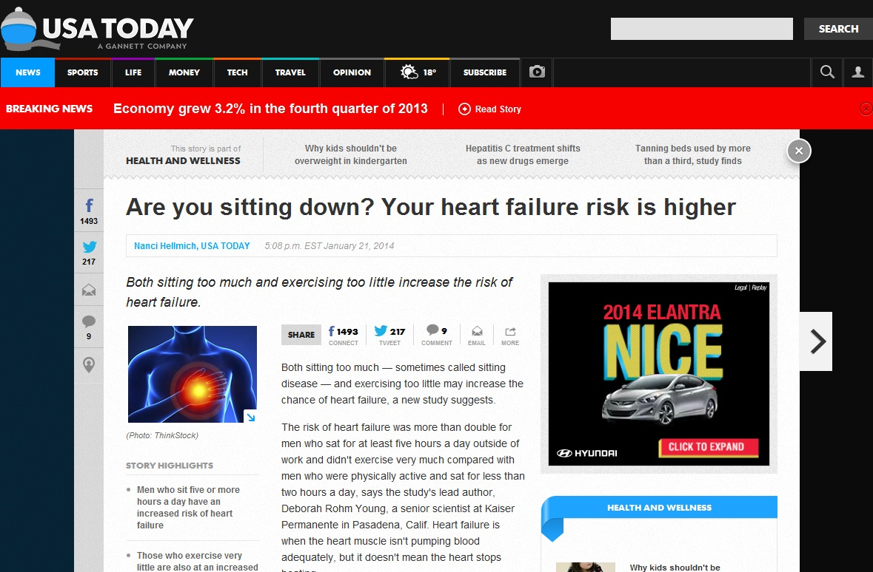
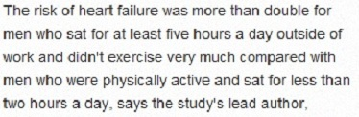

Slide 4
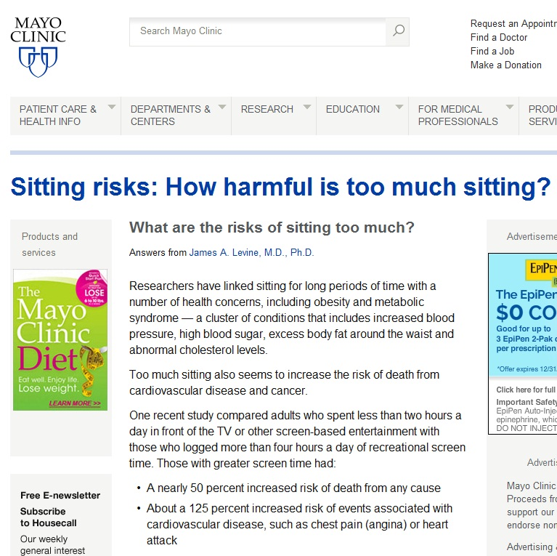


Slide 5
Inactivity Physiology
vs
Exercise Physiology
Paradigm Shift
Notes:
I uncovered a new field, Inactivity Physiology, which is just getting underway. This discipline stands in contrast [Click 1] to Exercise Physiology.
Exercise physiology is a well-established, well-researched, well-documented field. It explains those physiological changes that occur when we’re exercising or playing sports – like inc. HR, BP, respiration, adrenaline, etc.
Inactivity Physiology is pretty much a brand-new field. Lots of research starting to happen in this field. In 2012, over 1000 articles were published.
This field is changing the way we think about muscles when they’re active and more importantly, when they’re inactive. And this represents a paradigm shift.
[Click 2]: The paradigm shift is shifting from thinking about muscles merely in terms of the movement they provide, to understanding that inactive muscles can have a profound (and deleterious) effect on our physiology.

Slide 6
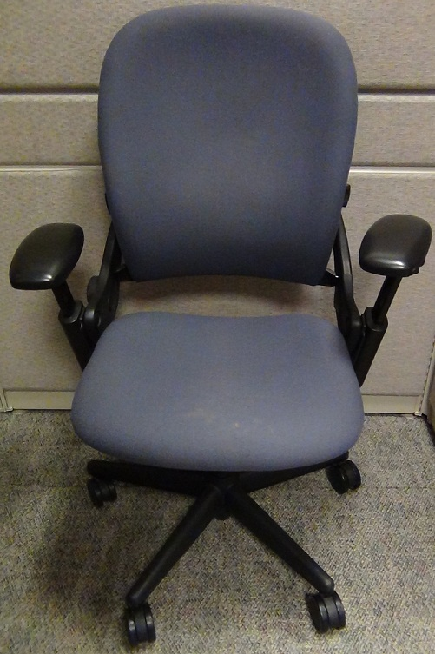
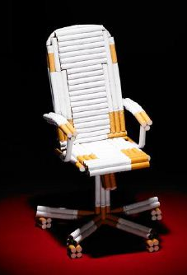
Physiology of Inactivity
(Or what happens when you sit?)
Sitting 8-11 hours/day: 15% more likely to die than if sit for fewer hours.
Sitting > 11 hours/day: 40% more likely to die from any cause.
Sitting:
The New Smoking
Notes:
So what is the physiology of inactivity?
Why is it that…
[Click 1] Sitting 8-11 hrs…
Or [Click 2] Sitting > 11 hrs…

Slide 7
New findings - Inactivity Physiology
Changes in enzyme activity (LPL)
Changes in gene expression (LPP1)
Notes:
This new field -- Inactivity Physiology -- which is different from Exercise Physiology, is beginning to identify the underlying biologic mechanisms that contribute to such poor health outcomes.
For today’s talk, I’ll cover just two of those biologic mechanisms:

Slide 8
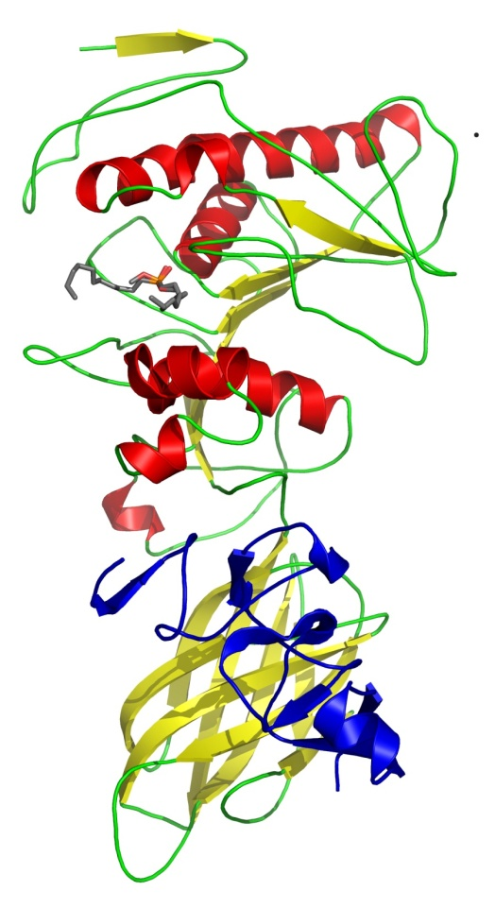
1. Lipoprotein Lipase (LPL)
Water-soluble enzyme
Breaks down triglycerides (Most common form of fat)
Affects uptake of triglycerides
Found in heart, muscle and fat
Notes:
Drawing from Wikipedia – released by author into public domain, with no copyright restrictions. (https://en.wikipedia.org/wiki/File:Pancreatic_lipase%E2%80%93colipase_complex_with_inhibitor_1LPB.png)

Slide 9
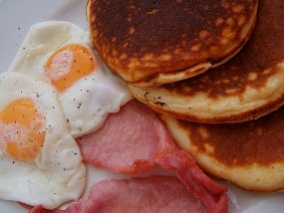
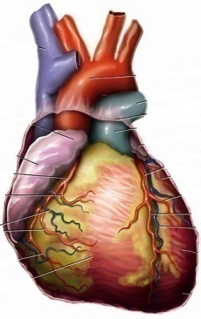
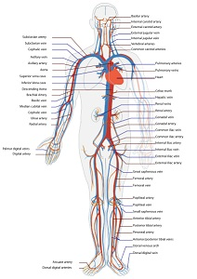

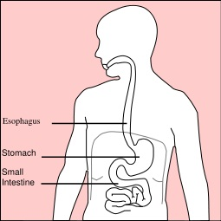
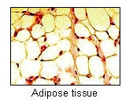
Inactive skeletal muscles
Active Skeletal Muscles
LPL
Triglycerides
Heart drawing: www.tiesworks.com
Notes:
Male adult heart: 10 oz, 70 beats/min, 2.8 billion beats/lifetime
Female adult heart: 8 oz, 78 beats/min, 3.1 billion beats/lifetime
~640 muscles in an adult, accounting for ~2/5 of body weight.
Drawings from Wikipedia, released into Public Domain by the creators,
Food: https://en.wikipedia.org/wiki/File:Good_Food_Display_-_NCI_Visuals_Online.jpg
Stomach: https://en.wikipedia.org/wiki/File:Stomach_diagram.svg
Circulatory System: https://en.wikipedia.org/wiki/File:Circulatory_System_en.svg
Heart: https://en.wikipedia.org/wiki/File:Wiki_Heart_Antomy_Ties_van_Brussel.jpg
Gastrocnemius: https://en.wikipedia.org/wiki/File:Gastrocnemius.png#filelinks
Adipose Tissue: https://en.wikipedia.org/wiki/File:Illu_connective_tissues_1.jpg

Slide 10
LPL
Affected by activity of skeletal muscles
Inactive
Not moving
Sitting/lying down
Little/no contraction in skeletal muscles
Active
Moving
Standing, walking
Contraction of skeletal muscles
NOT necessarily “exercise”
Low-intensity physical activity (LIPA)
Notes:
Muscle LPL is exquisitely sensitive to the activity level. It is the activity level of the muscles that determines whether the triglycerides are burned in muscle, or stored in fat.

Slide 11
Hamilton, MT; Hamilton, DG and Zderic, TW. Diabetes. 2007
Notes:
The red bar shows the level of muscle LPL at 10 hours = 20% of the amt in active muscles.

Slide 12
Hamilton, MT; Hamilton, DG and Zderic, TW. Diabetes. 2007
Notes:
HDL is your “good” cholesterol. Look what happens to the level of HDL cholesterol. After 1 day of inactivity, it drops by ~20%.

Slide 13
2. LPP1 (Gene in Skeletal Muscle)
One of many genes that regulates blood flow within muscles
Also involved in blood clotting
Turned on/off by physical activity/inactivity
Suppressed after hours of sitting
Exercise – not effective countermeasure

Slide 14
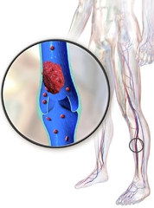
Inactivity and DVT
Deep Vein Thrombosis (DVT)
1/1000 adults at risk for DVT in U.S.
Notes:
Illustration : DVT (https://en.wikipedia.org/wiki/File:Blausen_0290_DeepVeinThrombosis.png)

Slide 15
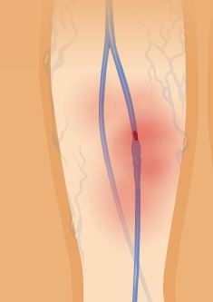
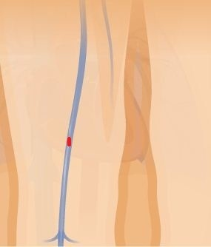
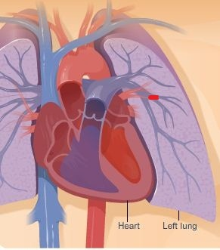
Illustration: NIH

Slide 16
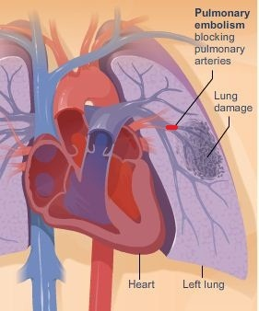
DVT and Pulmonary Embolism
60,000 - 100,000 deaths due to DVT/PE (CDC)
95% of pulmonary embolism cases caused by DVT
Illustration: NIH
Notes:
Illustration : DVT (https://en.wikipedia.org/wiki/File:Blausen_0290_DeepVeinThrombosis.png)

Slide 17
Notes:
We tend to grossly underestimate the amount of time that we spend sitting. I was curious about what MY workday looked like, so I decided to chart out, hour-by-hour, how many minutes were active and how many minutes were inactive. So here’s one day in the Life of Delia. My day starts at 6 am, and for the next 60 minutes, I’m on my feet, getting ready for work. During the 7 o’clock hour, let’s say I sit down for 15 minutes when I’m eating breakfast, then get in my car and drive 30 minutes to work. Then I walk from my parking space to my office, and let’s say that takes 15 minutes. So for that hour, I have 15 active minutes and 45 inactive minutes. The Active Minutes are charted in blue, above the horizontal line and the Inactive Minutes are shown in white, below the horizontal line.

Slide 18
Inactive minutes: 827
Active minutes: 193
“Active” Minutes: 193

Slide 19
Be (Pro) Active
Avoid prolonged sitting
Get up and move
A little goes a long way

Slide 22
Inactive minutes: 705
Active minutes: 315

Slide 23

Suggestions
At Work
Stand up/walk when on phone (cordless)
Stand up when reading online (emails, web pages, documents)
Put printer further away
Use small water bottles or cups & fill them frequently
Goal: 5 min/hour

Slide 24
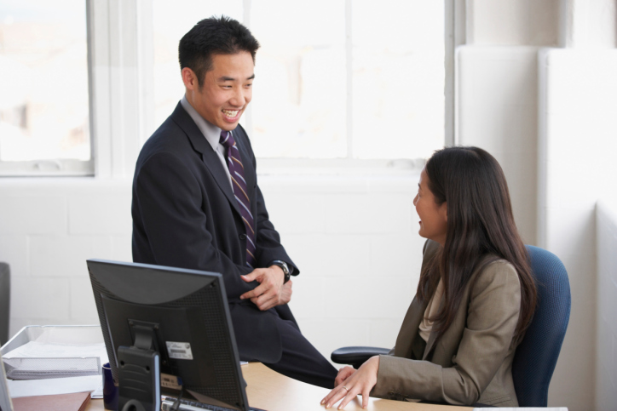
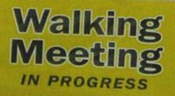

Suggestions
At Work
Walk and Talk
  Walking meetings
  Instead of email
Set reminders to get up (computer, smart phone)
Take Stand & Stretch breaks
Don’t eat lunch at desk!
Goal: 5 min/hour

Slide 25

Suggestions
At Home
Walk in evenings & on weekends (dogs are good)
Lose the TV remote
Stand up during commercials
Cook from scratch (stand)
Do yard work – manually
Goal: 10-20 min/hour

Slide 26
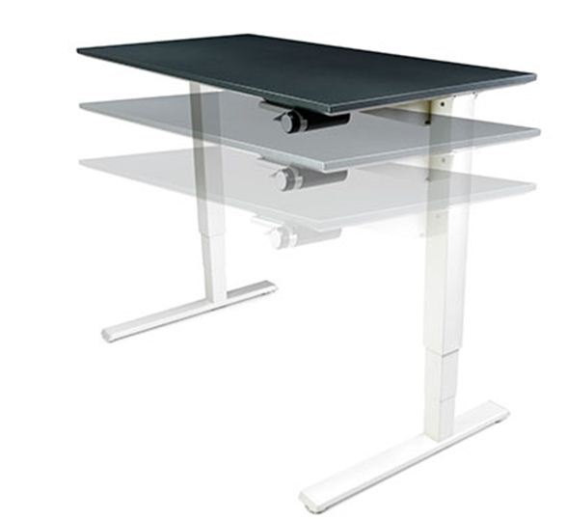
What about…
Sit/Stand Desks?

Slide 27
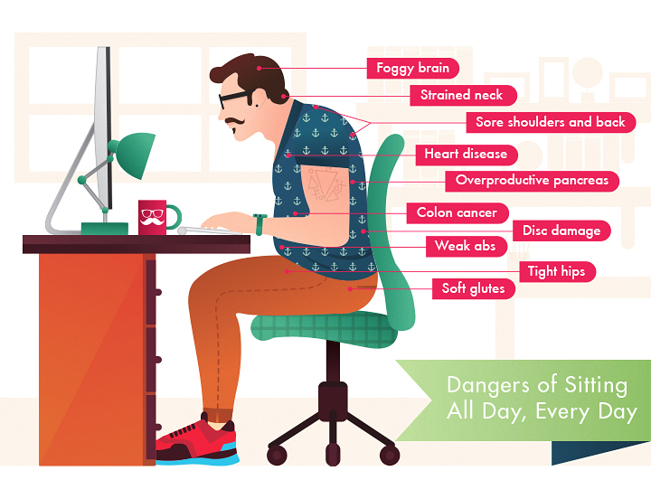
Sit to Stand Desks
Think Posture
Think Motion

Slide 28
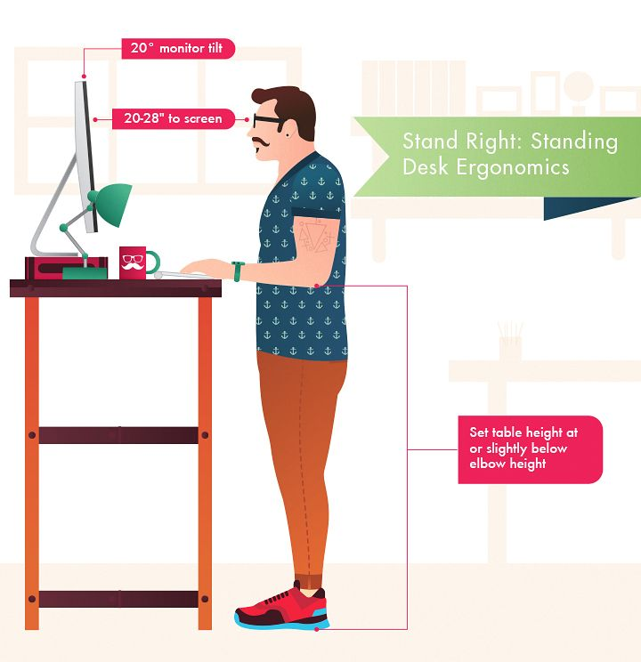
Sit to Stand Desks
Think Posture
Think Motion

Slide 29
Sit to Stand Desks
Think Posture
Think Motion

Slide 30
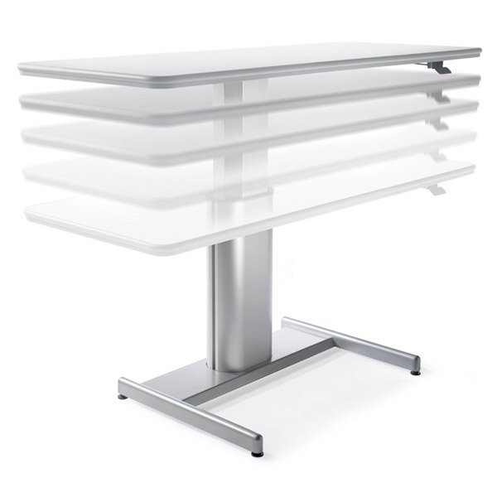
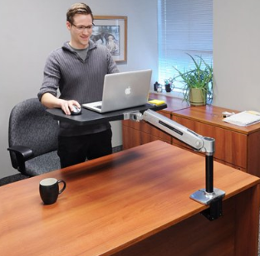
Sit to Stand Desks…Purchasing
Think about options…
Central Station?
Table Top?
Medical Need?

Slide 31
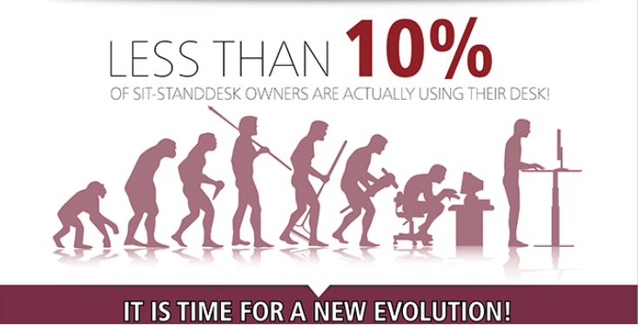
BUT…..
….. it is a true behavioral challenge to override the learned sedentary behavior that so many of us have adopted.

Slide 32
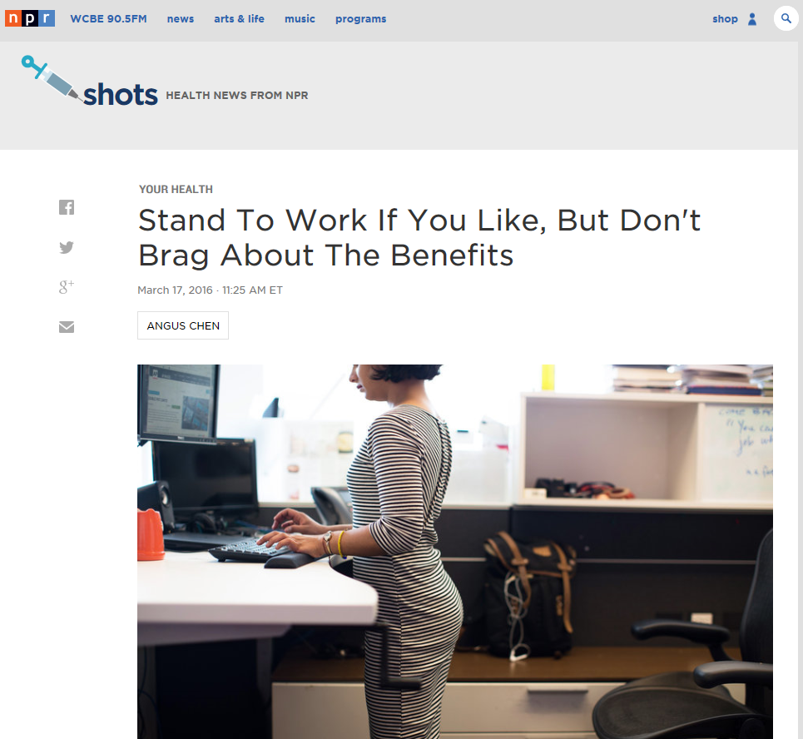
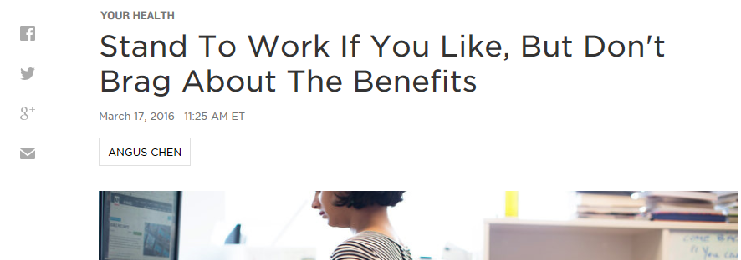
Reviews are still mixed

Slide 33
Keys to Success
Sit Less, Move More
Puttering, Shifting your weight, stretching, etc.
Don’t become a chair potato….
Think Posture!

Slide 34

The Millenial Office

Slide 35
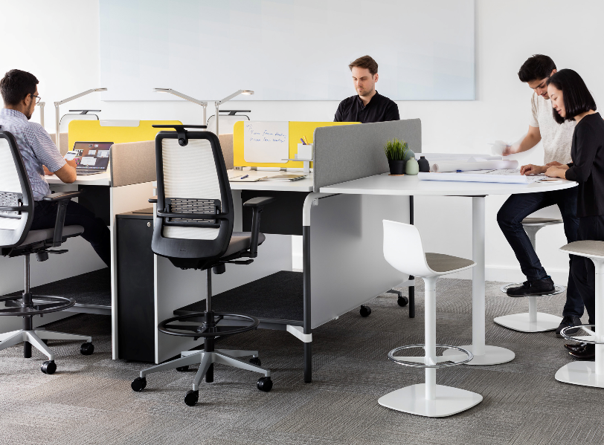
The Millenial Office

Slide 36
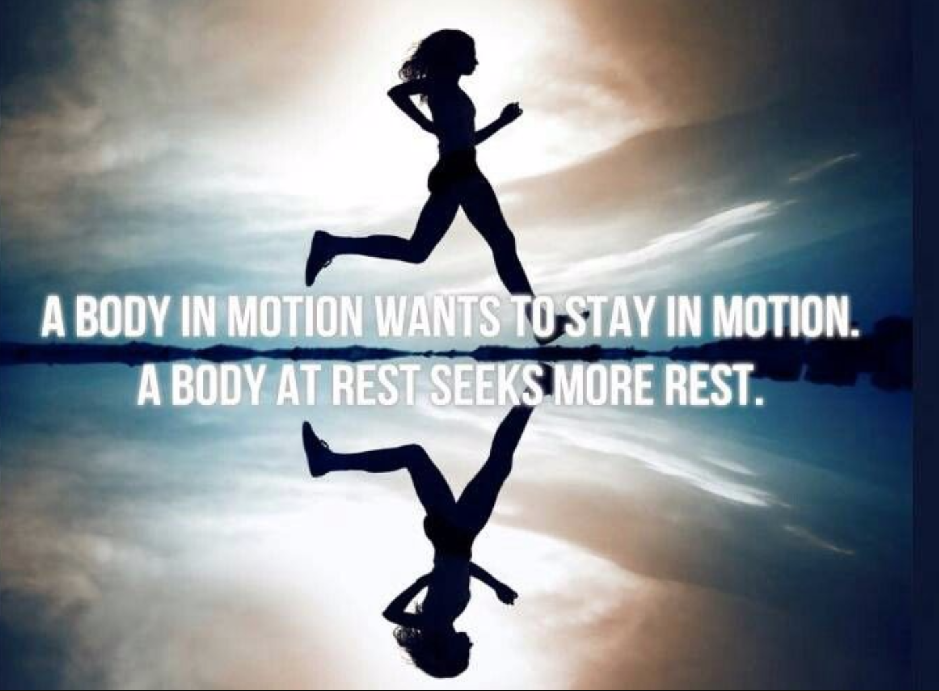

Slide 37
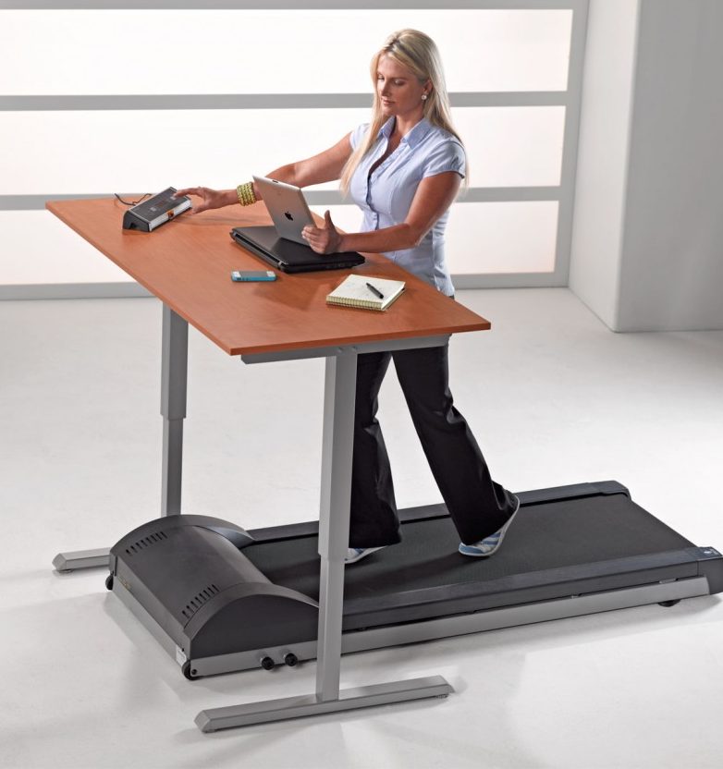
What about…
Treadmill Desks?
NO!

Slide 38
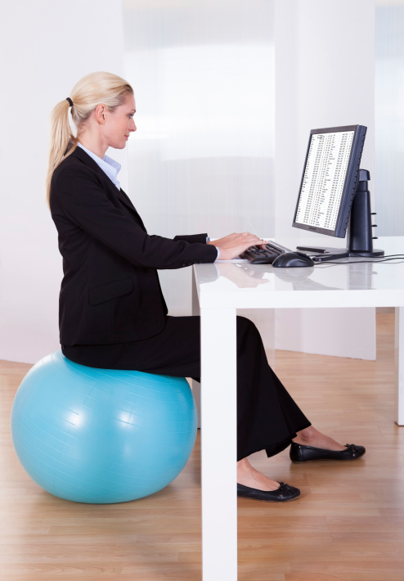
What about…
Ball Chairs?
NO!

Slide 39
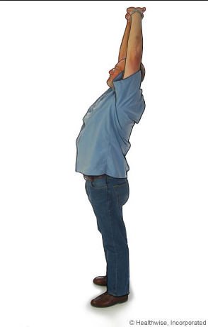
What about…
Stretching?
Definitely

Slide 40
Summary
Trigycleride levels affected by amount of physical activity
Blood flow/blood clotting affected by amount of physical activity
Time, not intensity

Slide 41
Summary
You cannot focus only on exercise time and ignore sitting time.
It is not one or the other, but both too much sitting and too little exercise create a public- health hazard.

Slide 42
  Take Home Message
  Sit less – move more
  Get off your seat – get on your feet

Slide 43
Questions?
Comments?

